Slide 1

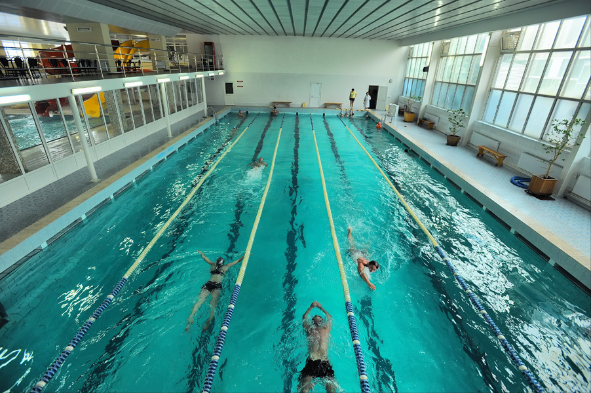
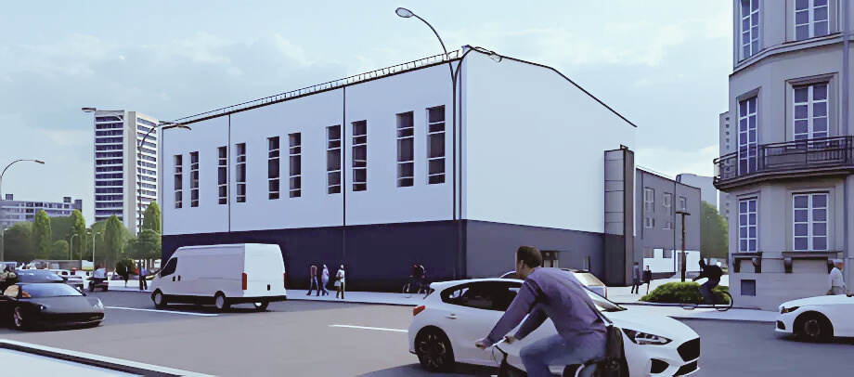
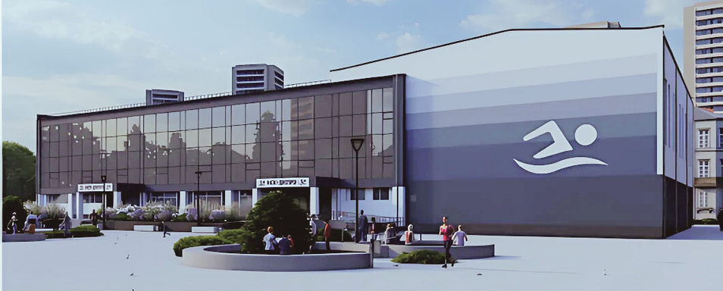
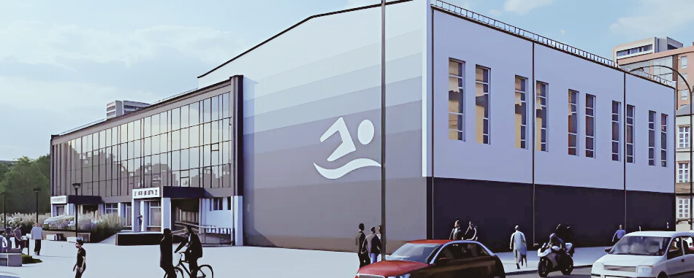


The sports and rehabilitation complex «DNIPRO» with the swimming pool in Cherkasy

Slide 2

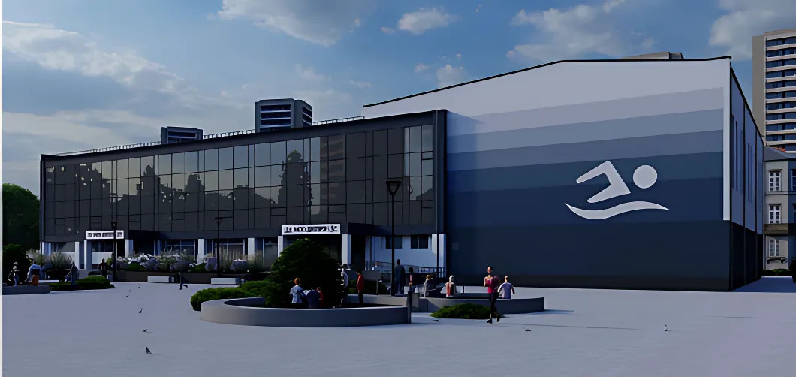
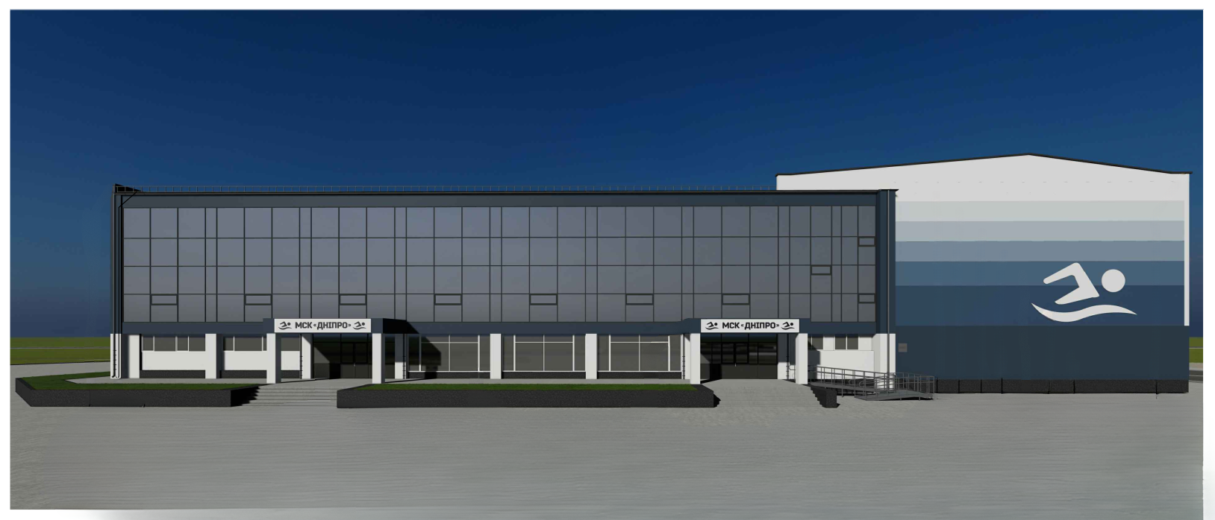
The Project of the sports and rehabilitation complex «DNIPRO» with the swimming pool
According to the started Project «Overhaul building of the sports complex with the swimming pool ME MSC «Dnipro» in Cherkasy”

Slide 3
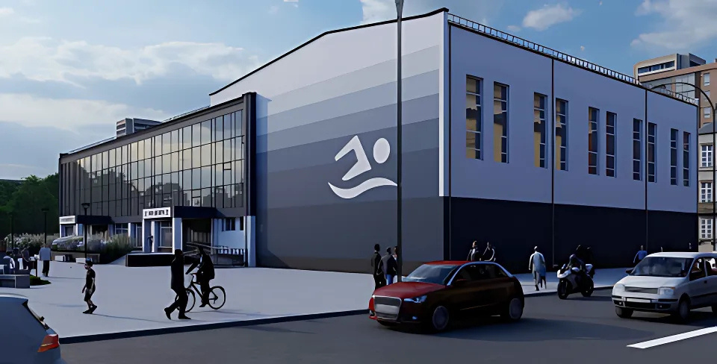
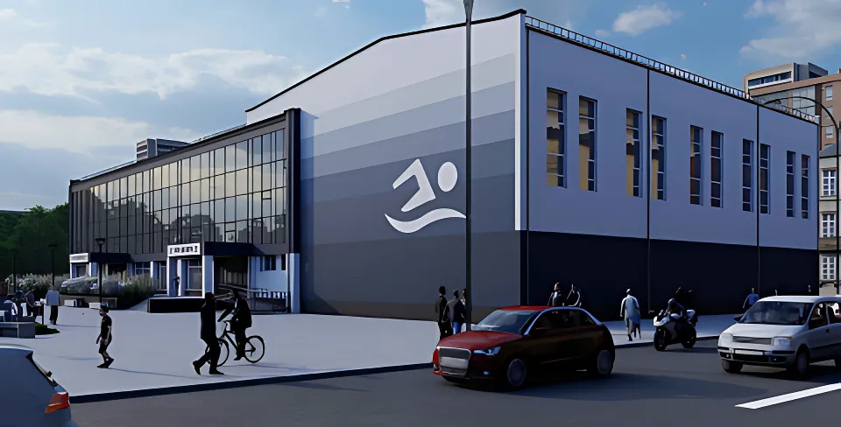





The goals of the Project are as following:
creation of the unified sports and rehabilitation area
cherkasy infrastructural development
vulnerable population groups support
social integration and inclusion development

Slide 4
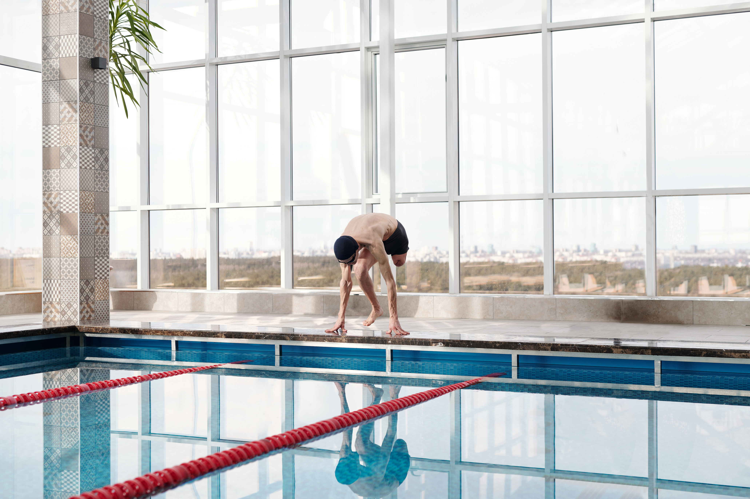


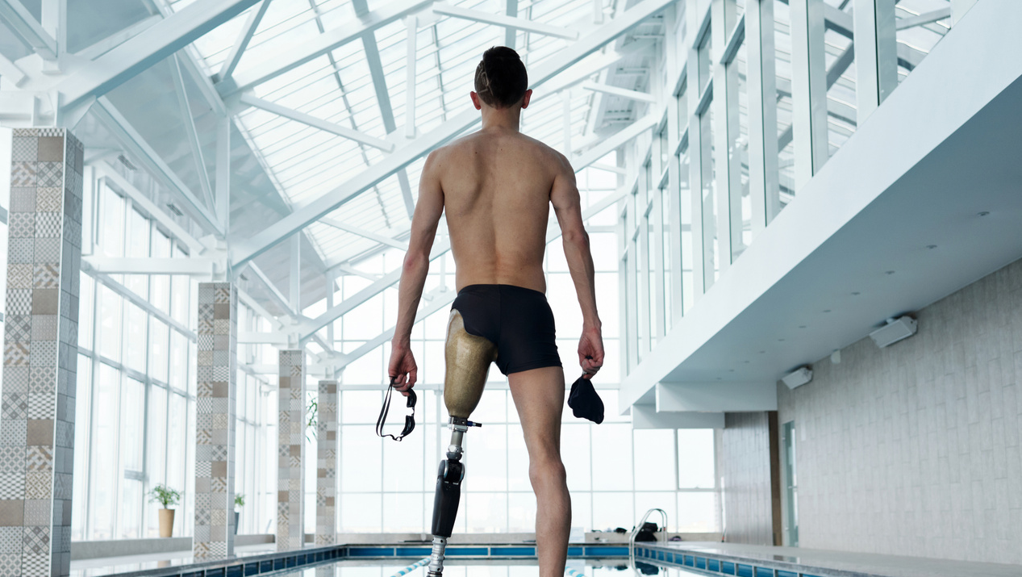

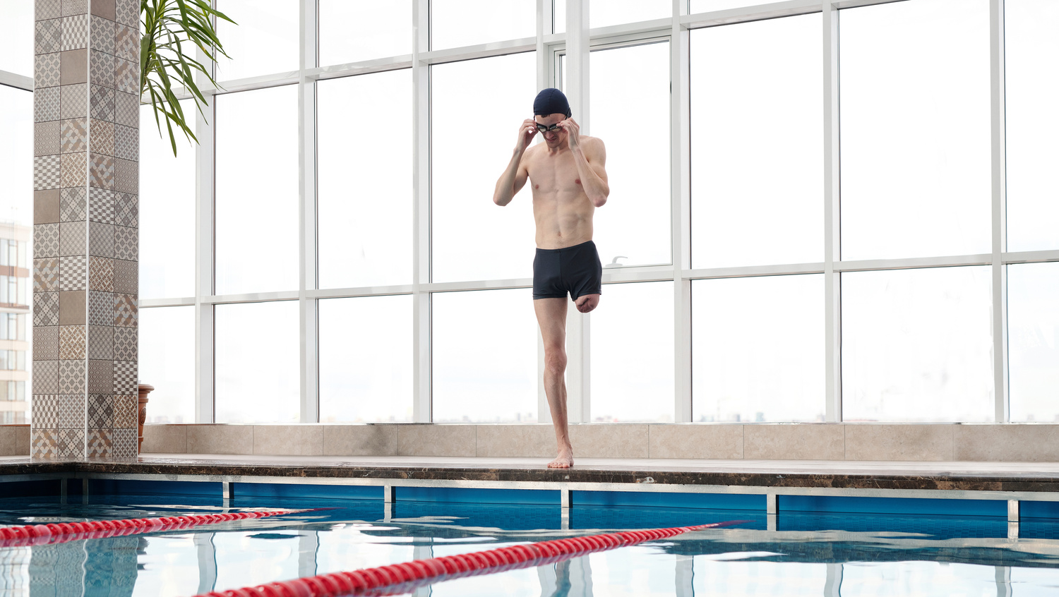

The quantity of visitors:
veterans, who will be able to go in for adaptational kinds of sport on the basis of the sports complex «Dnipro» – over 1 300 visitors
pupils of local sport schools and «invasport» sport school having 3–4-time trainings per week – 28 460 visitors per month in total
city dwellers, who visited the swimming pool individually – 4 230 visitors per months in total

Slide 5
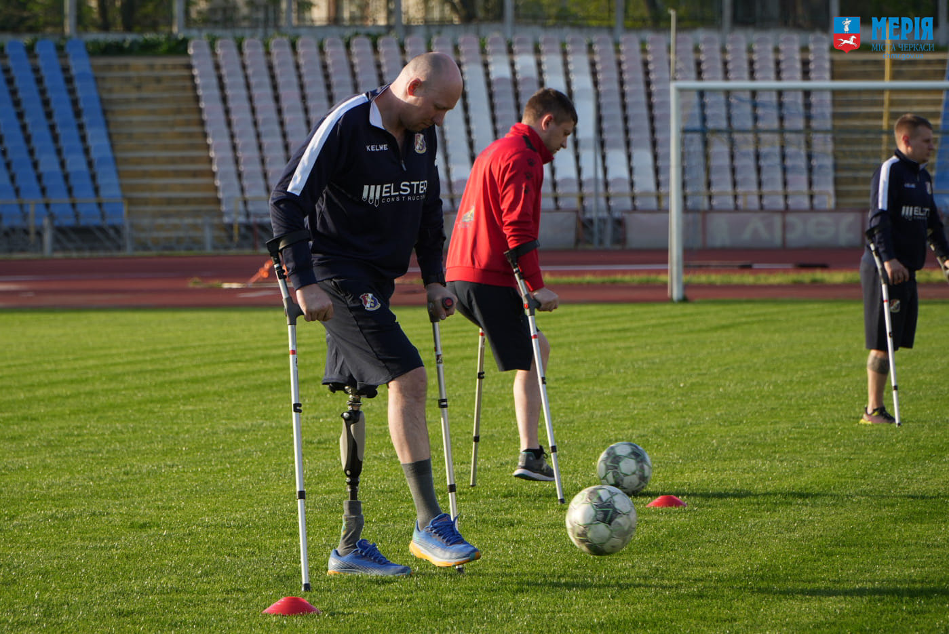
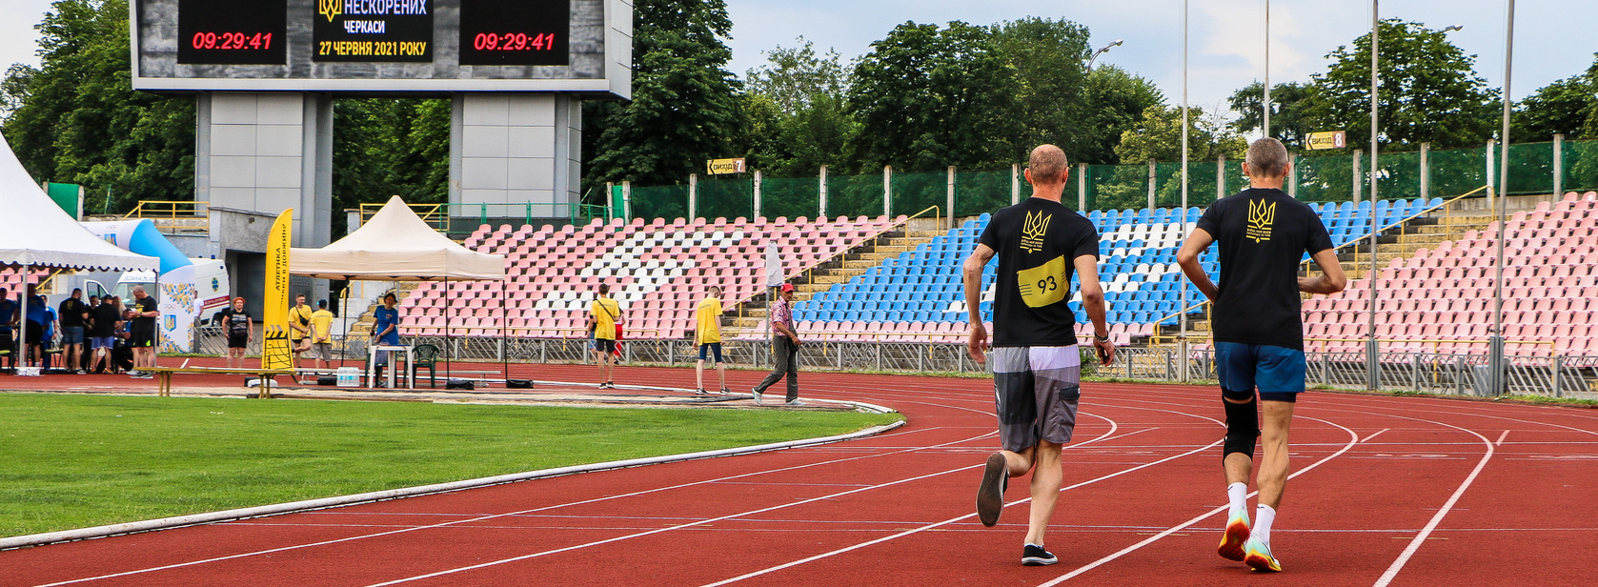
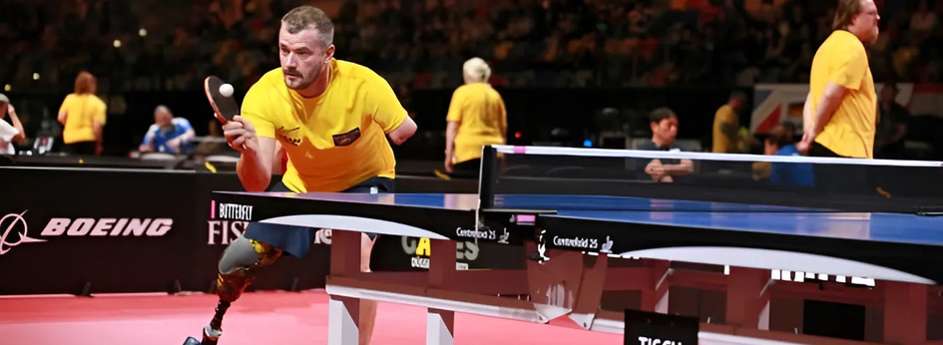

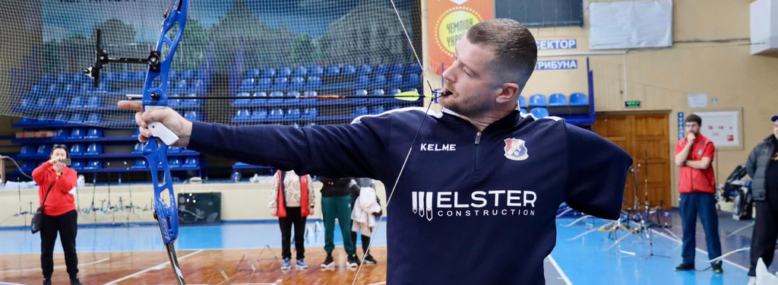


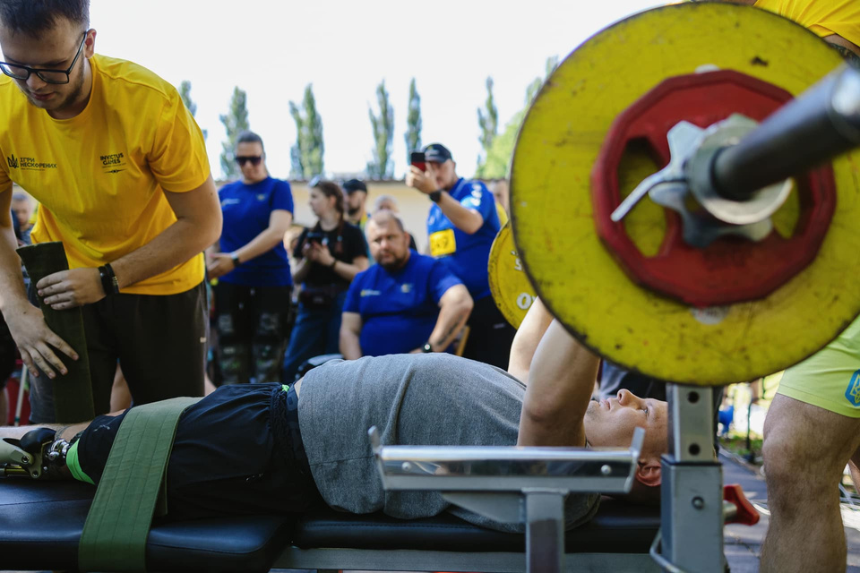

The Center for Physical Culture and Sports Rehabilitation is already functioning on the basis of the Municipal sports club «Dnipro», where war veterans are engaged in adaptive sports:
athletics
table tennis
archery
powerlifting

Slide 6
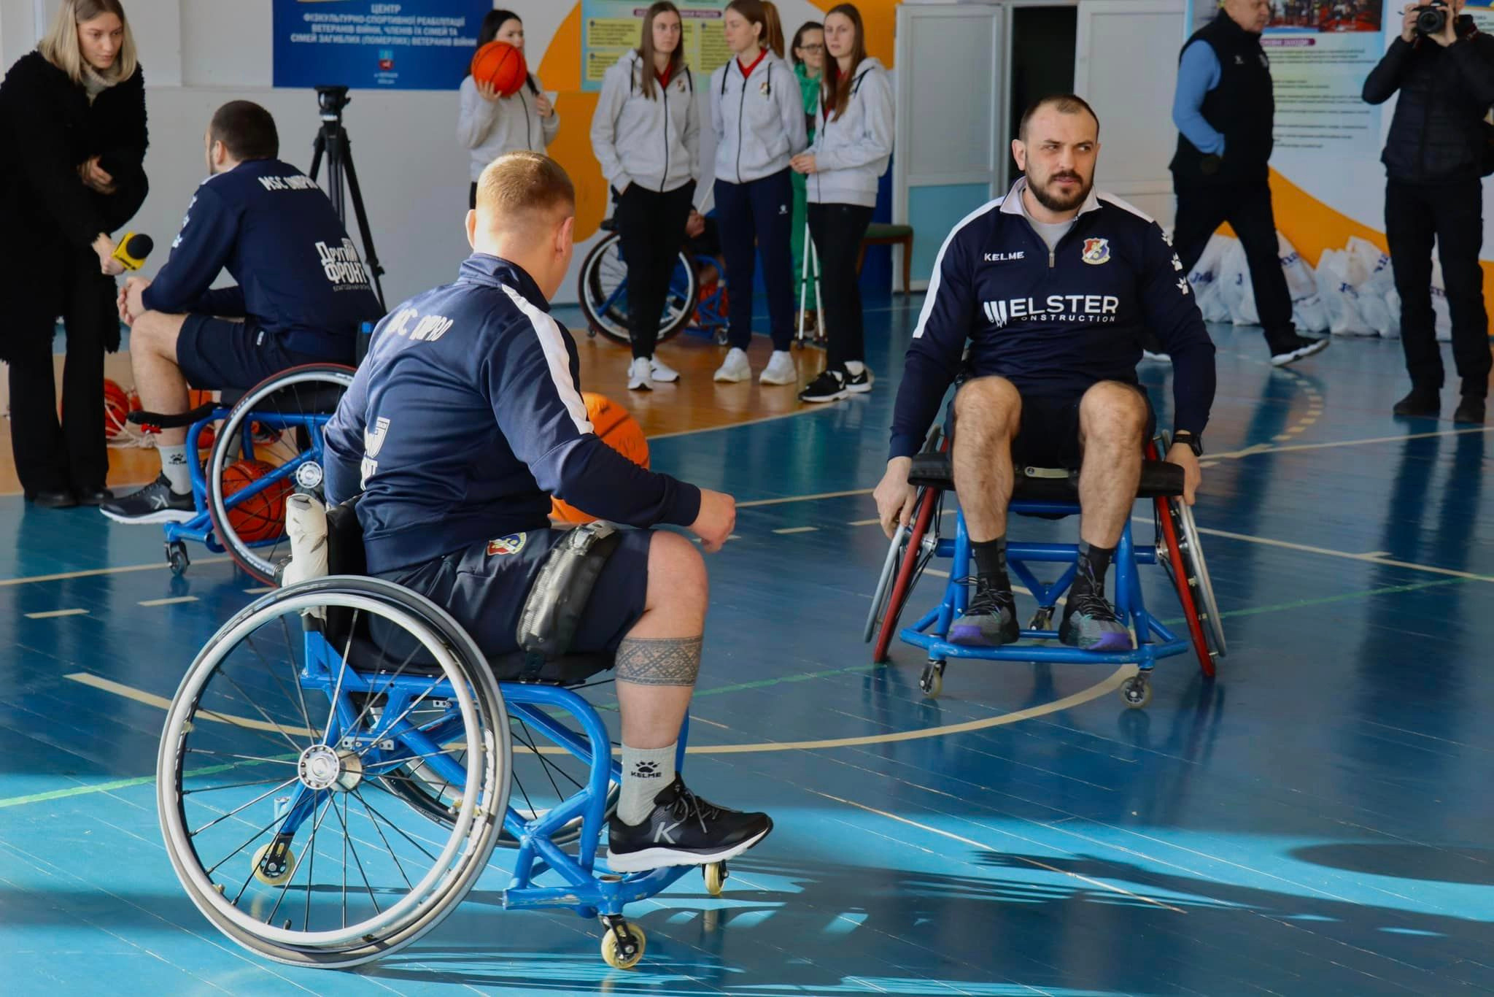


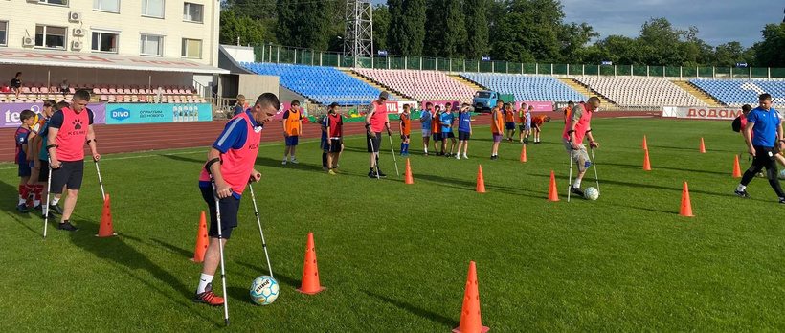
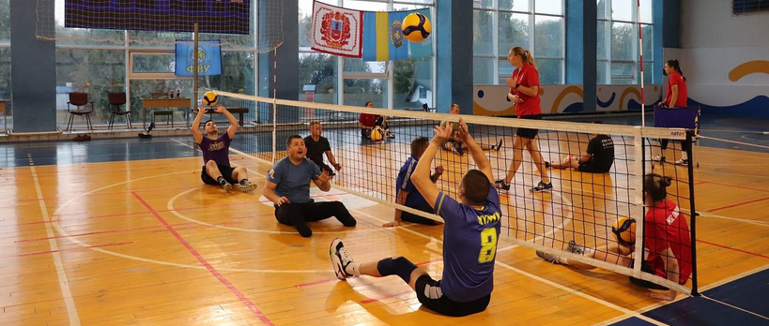
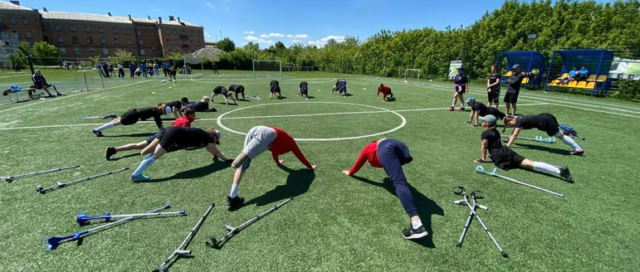
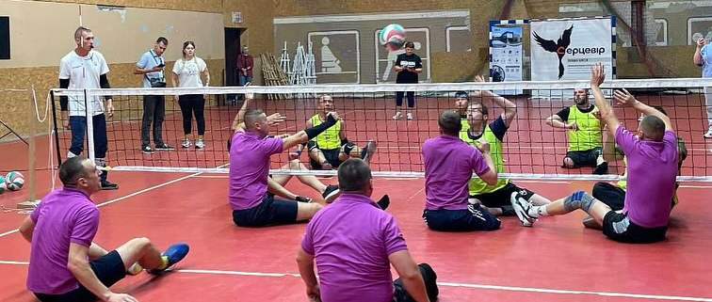
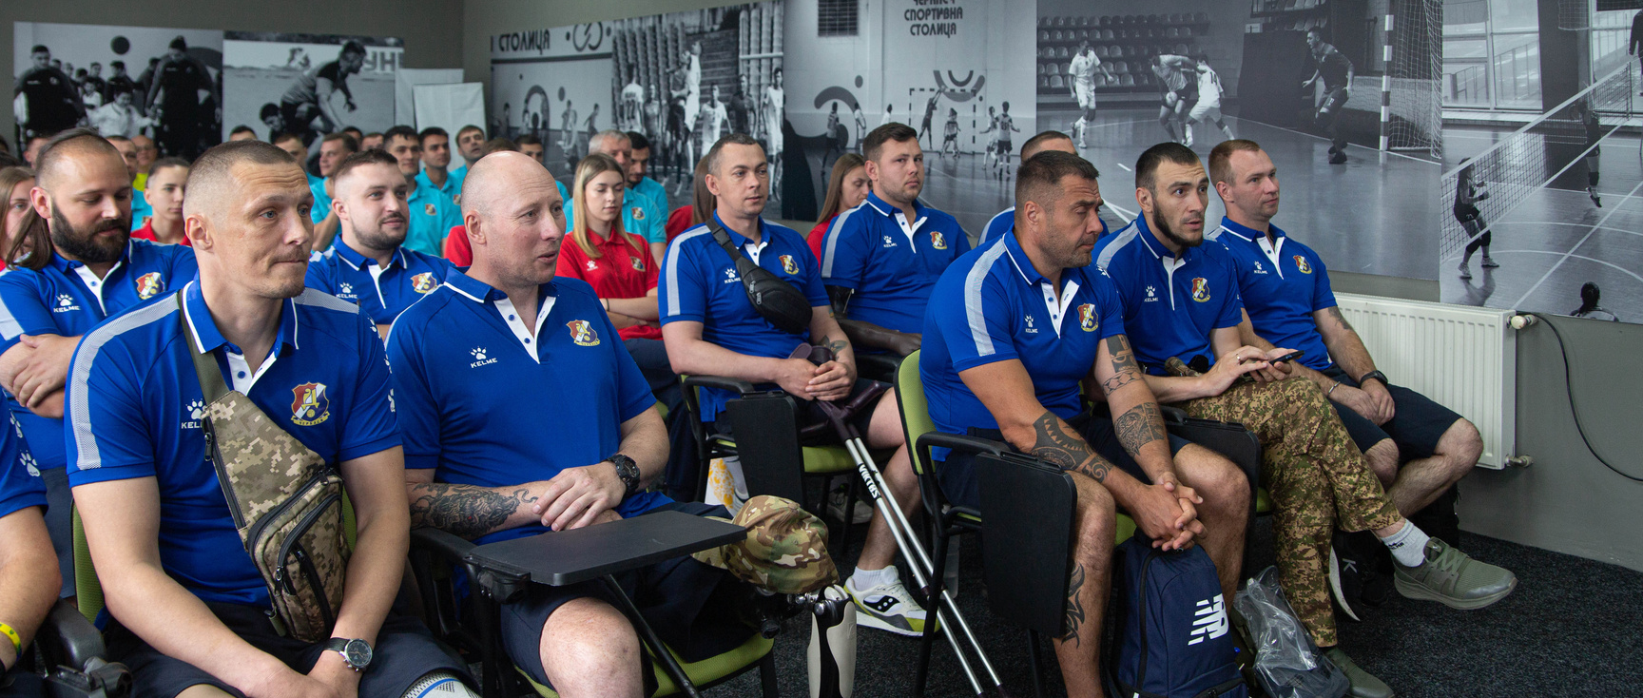
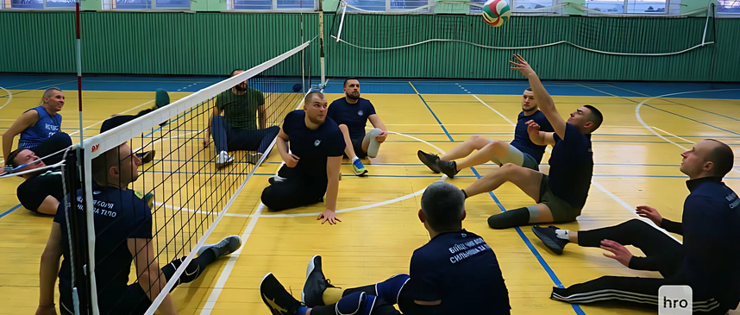
Team sports are also actively developing in the Center:
AMP football
sitting volleyball

Slide 7
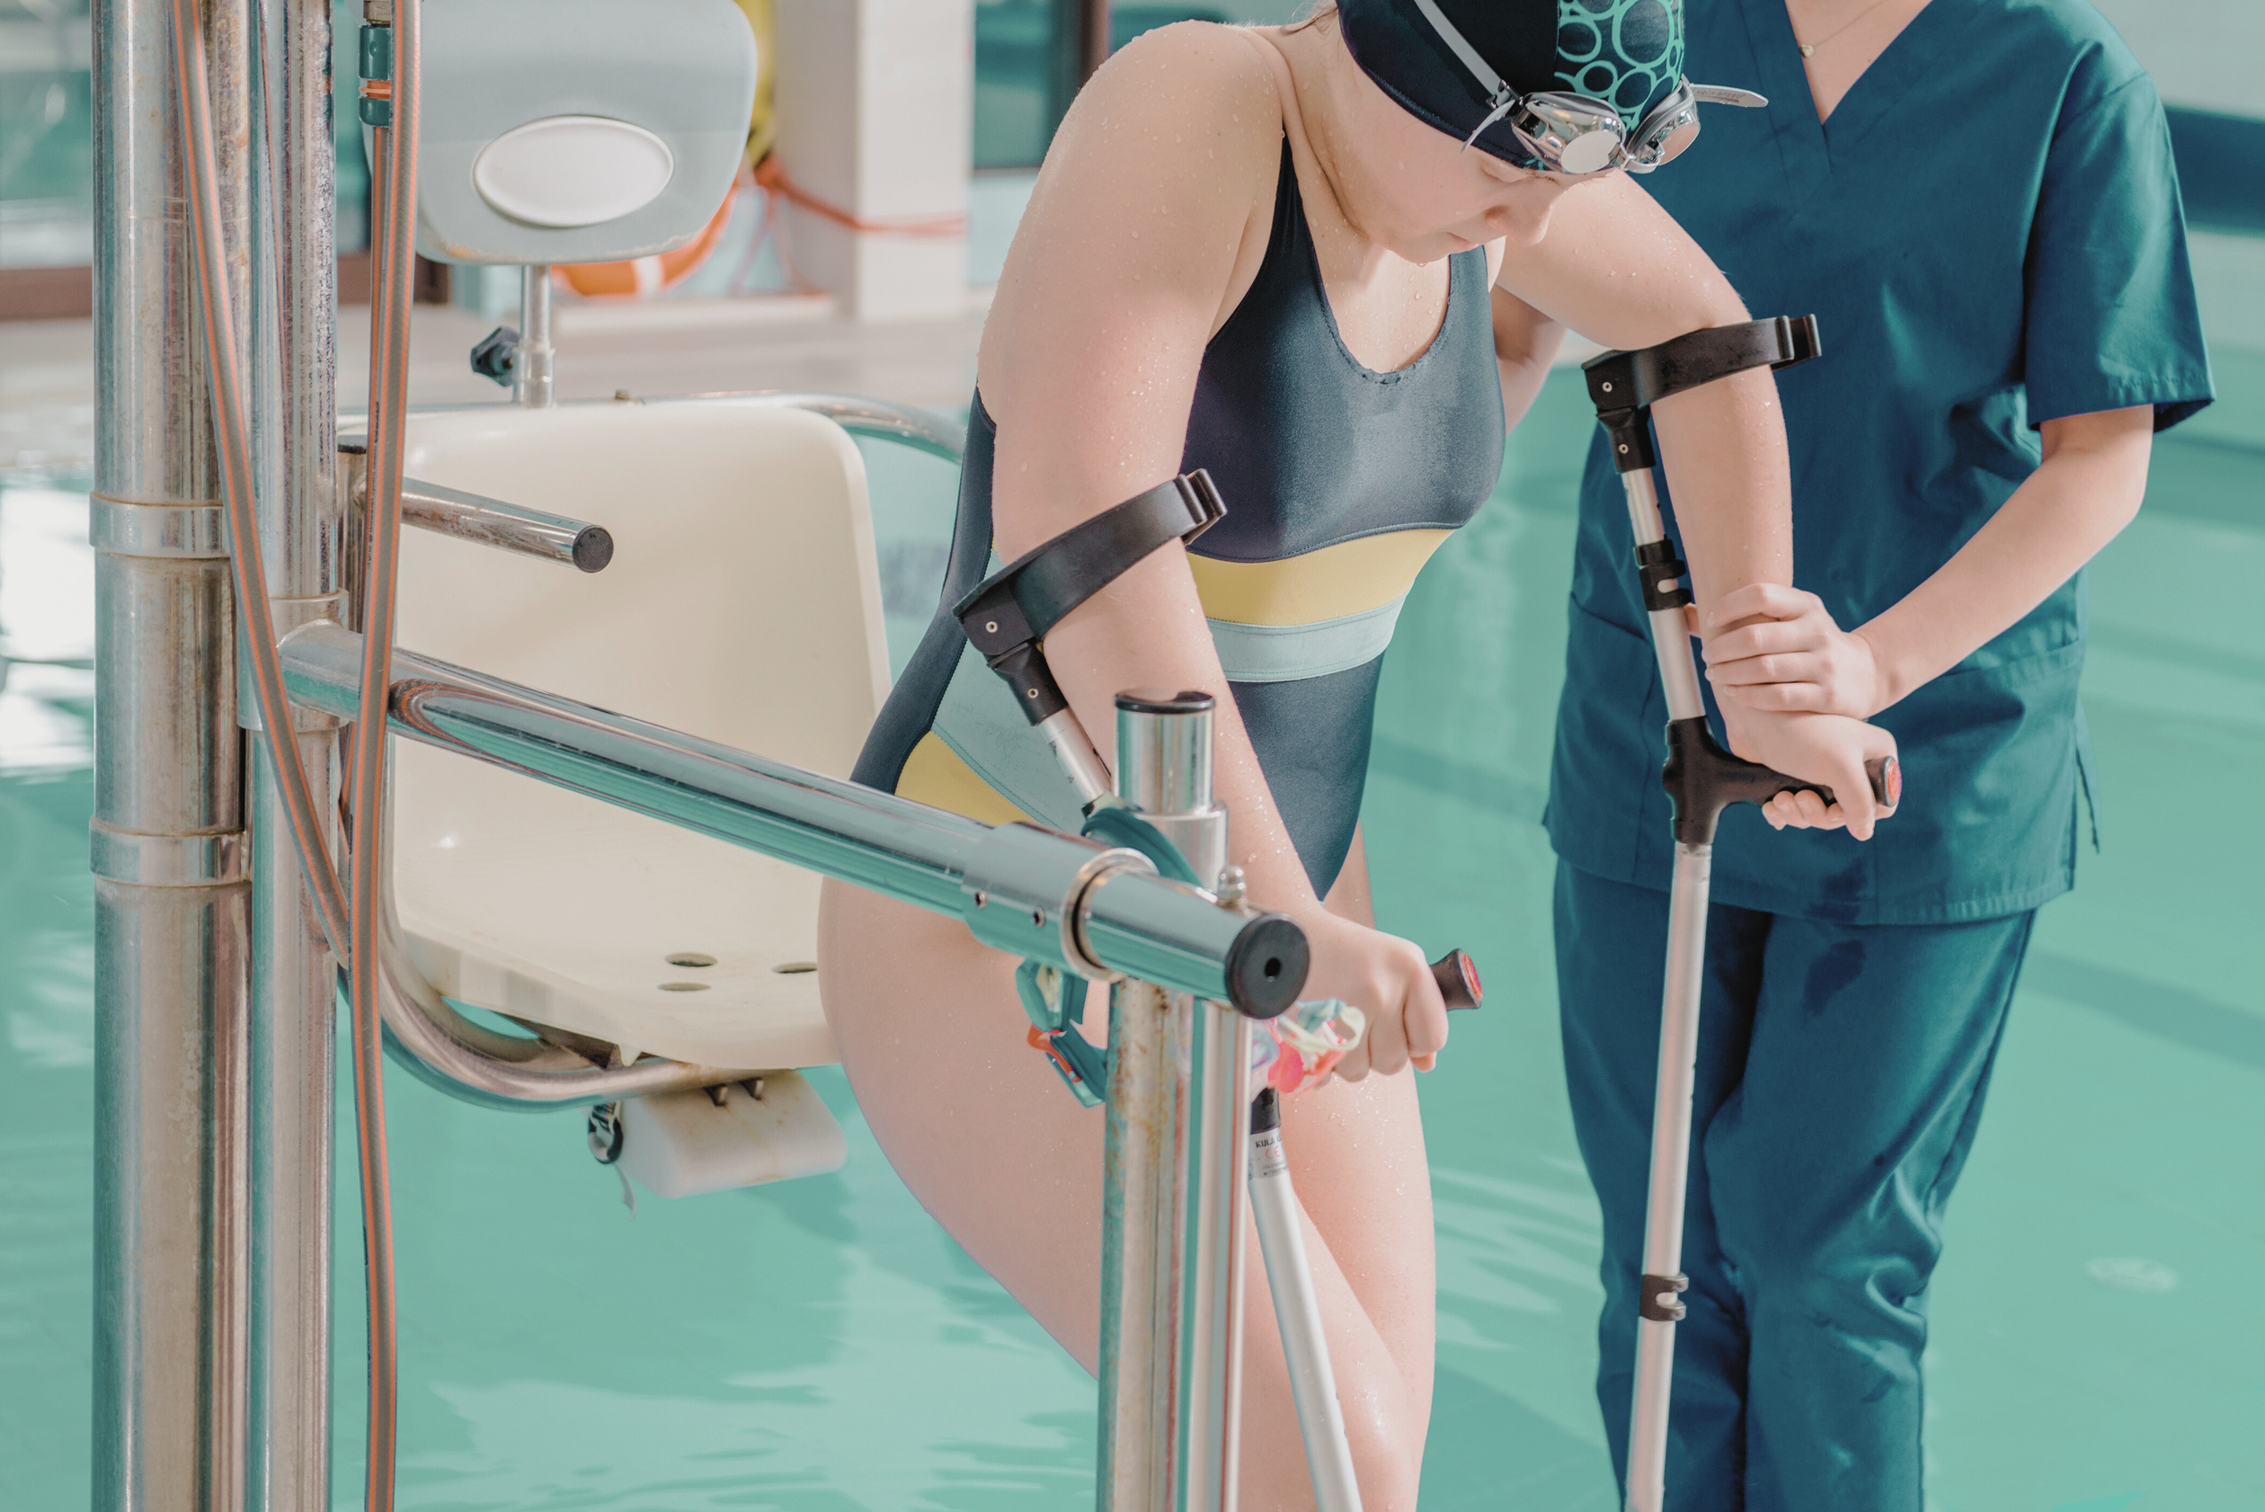
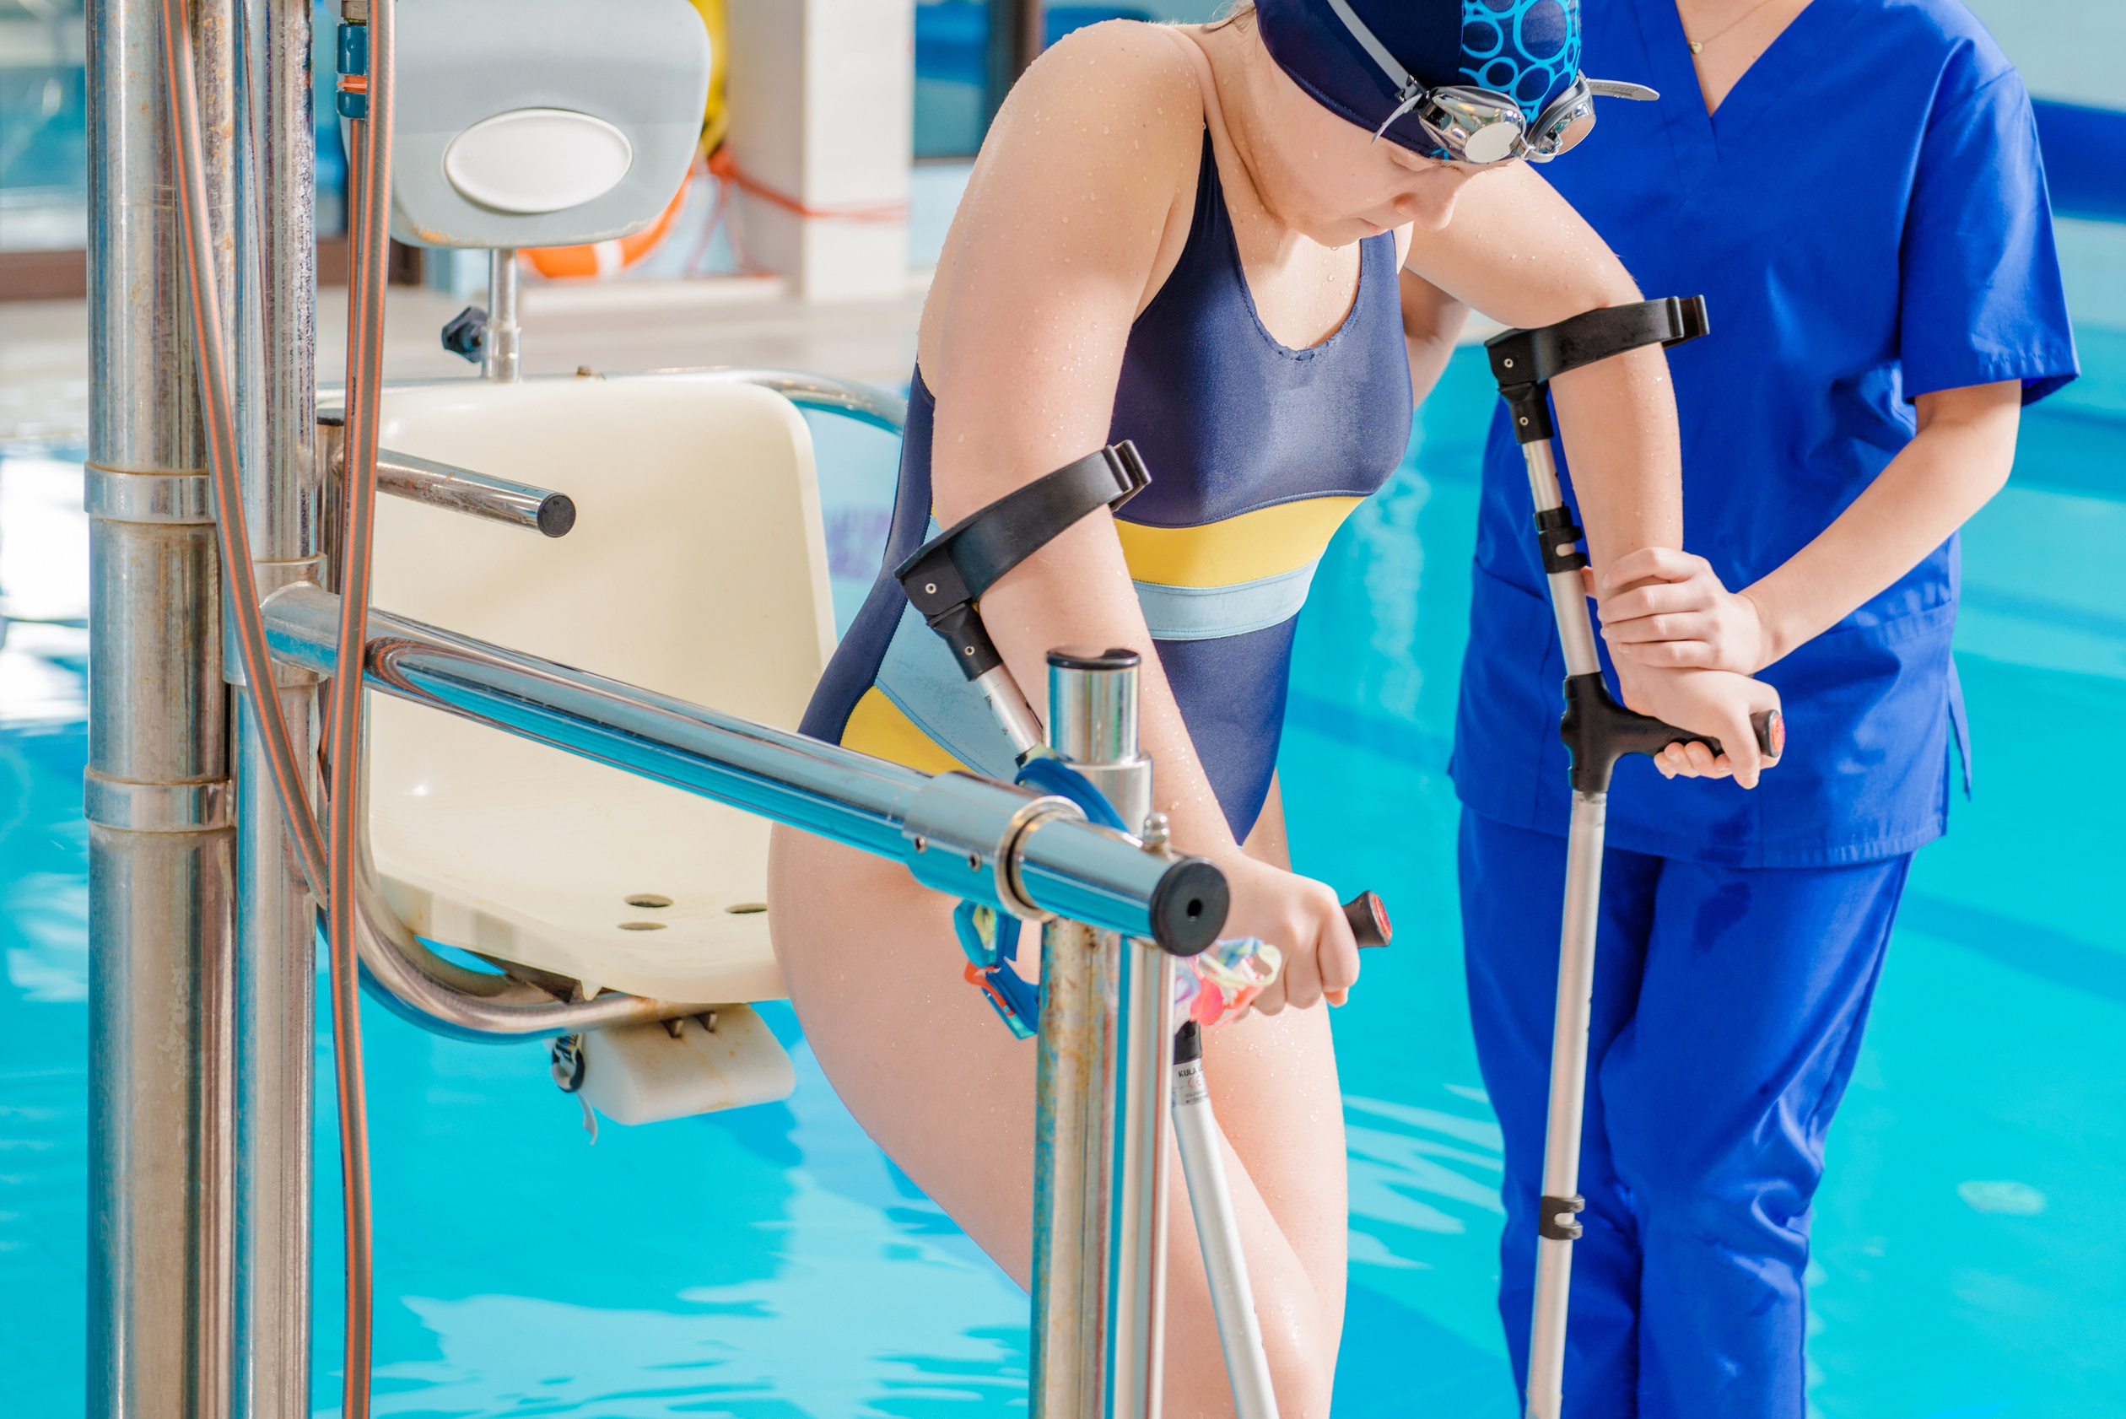

The sports and rehabilitation complex «DNIPRO» with the swimming pool
will provide the opportunity:
complex rehabilitation for veterans and their family member

Slide 8
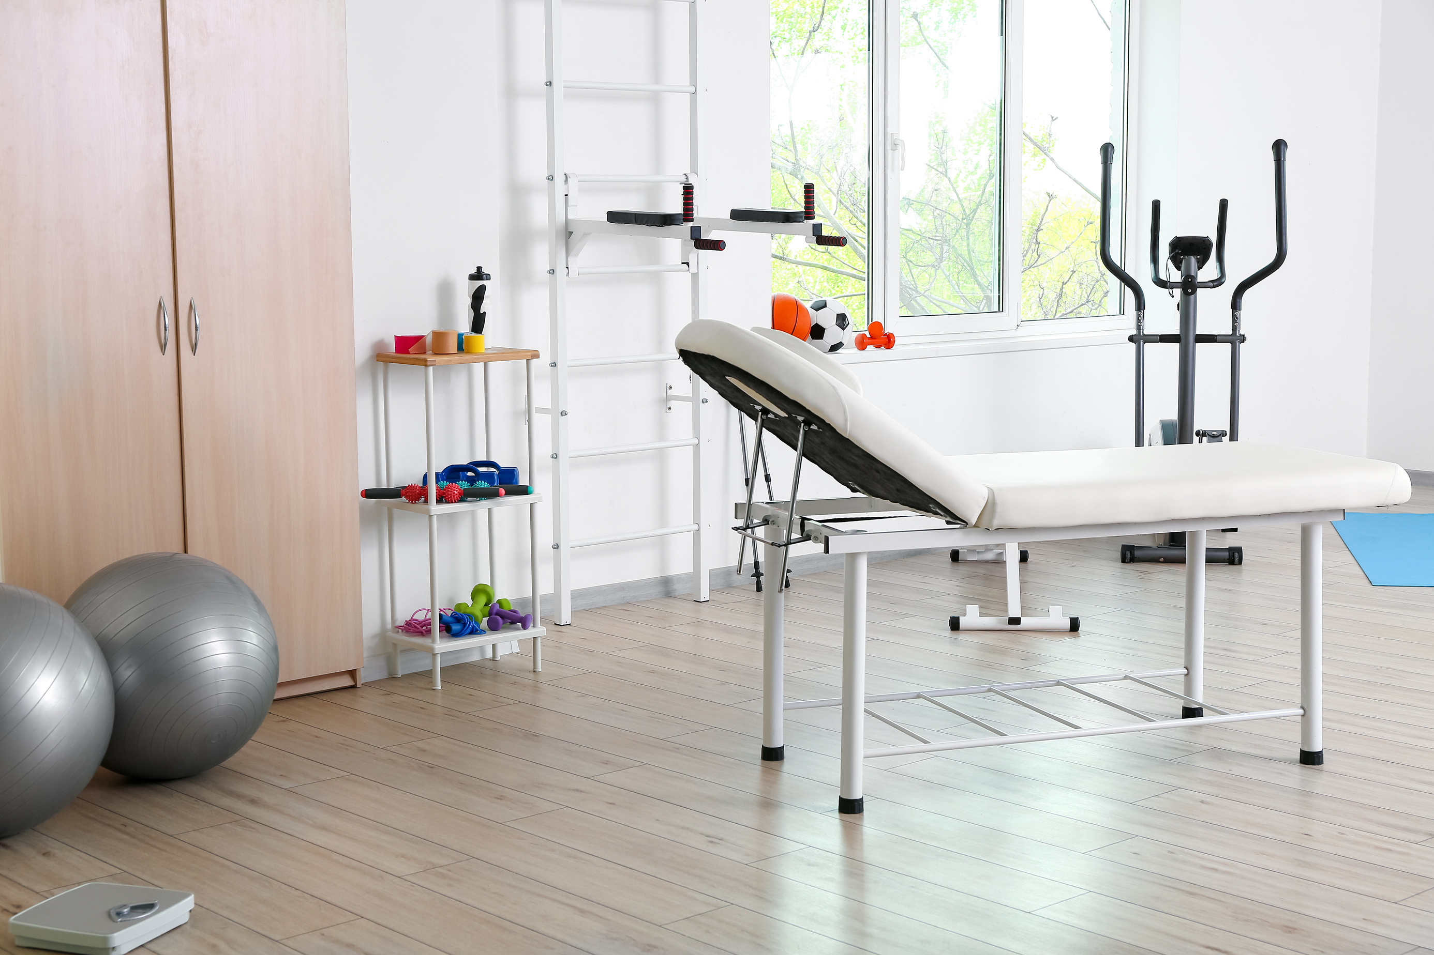

The sports and rehabilitation complex «DNIPRO» with the swimming pool
will provide the opportunity:
adaptational kinds of sport for people with disabilities

Slide 9
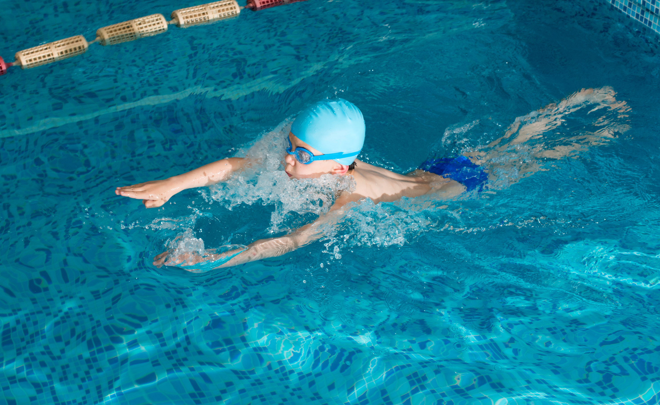

The sports and rehabilitation complex «DNIPRO» with the swimming pool
will provide the opportunity:
involvement of children from the region into the sport activities

Slide 10
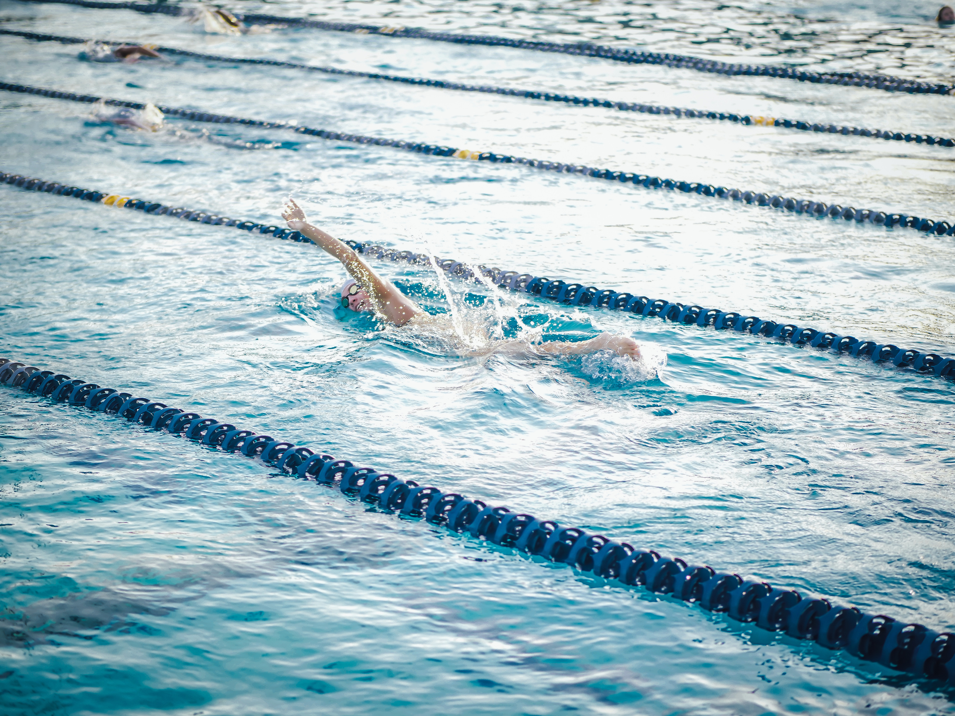

The sports and rehabilitation complex «DNIPRO» with the swimming pool
will provide the opportunity:
water sports for vulnerable population groups

Slide 11
The total estimated value of the Project is
~1 500 000,00 EUR
Funded
~270 000,00 EUR

Slide 12
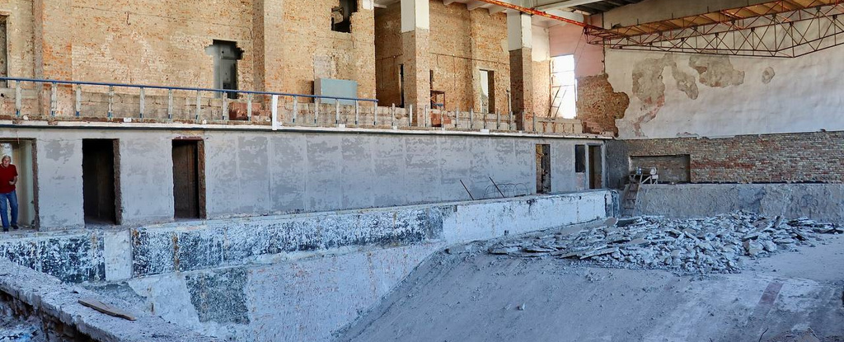

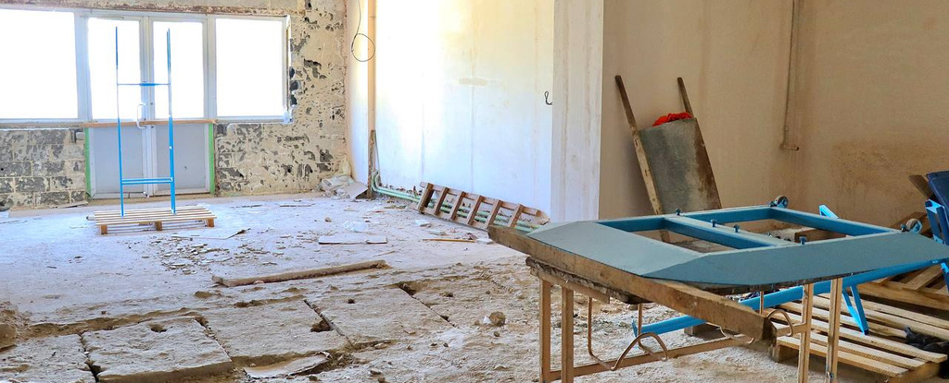


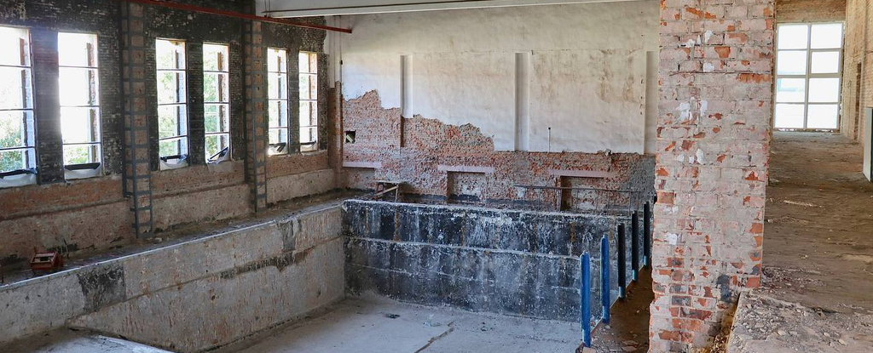

Works executed:
preparation works
dismantling works
reinforcement of brick piers
insulation and roofing works

Slide 13
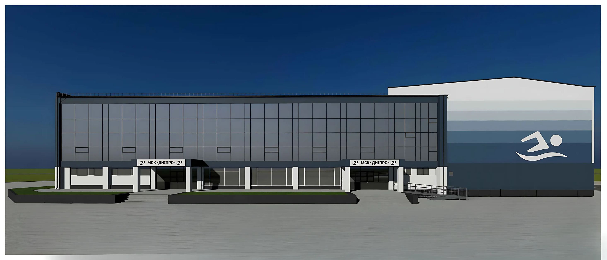

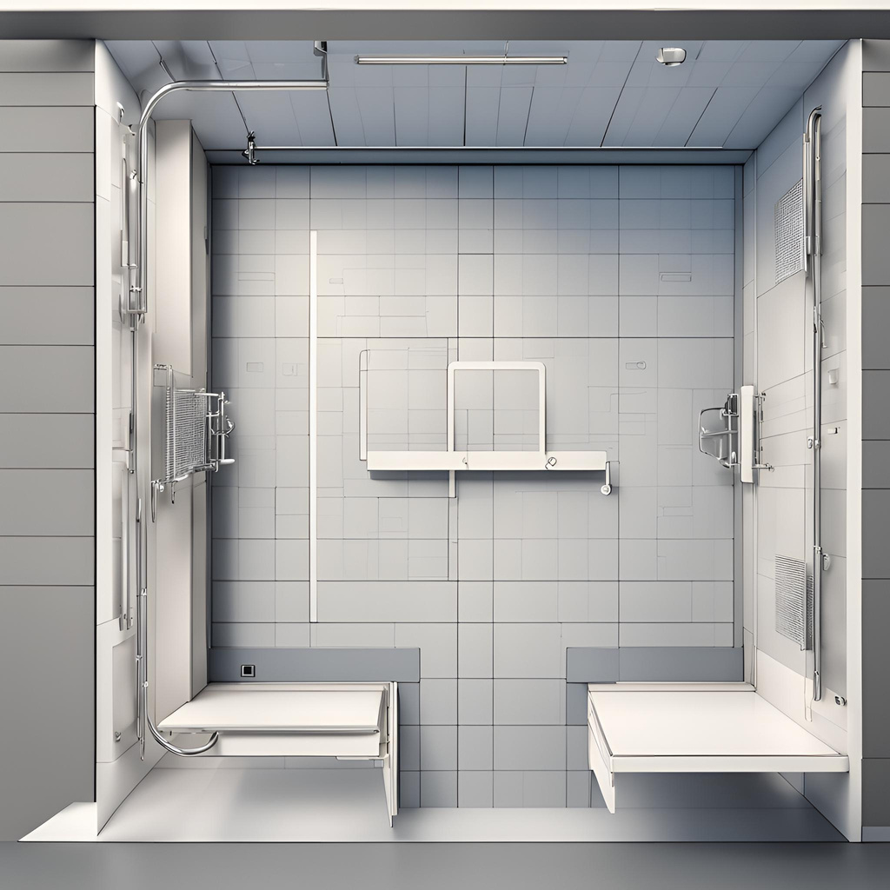



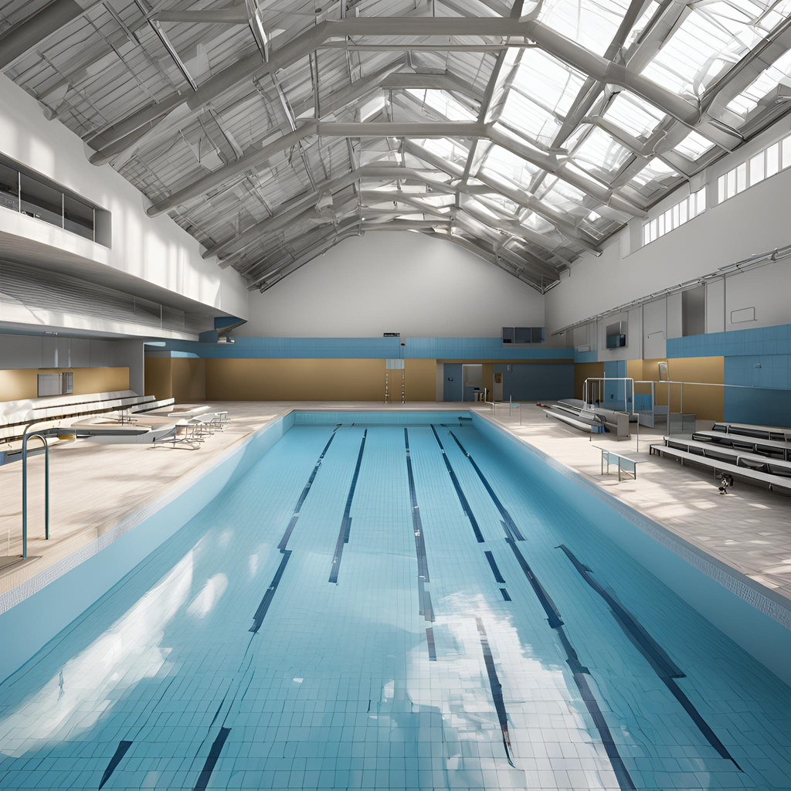


Scope of works for the following execution:
repairing works of the swimming pool bowl
warm floors and bypasses arrangement
heat insulation of the roof, ceiling arrangement
bathrooms, showers, vestibules arrangement
ramp arrangement
ventilation system installation

Slide 14
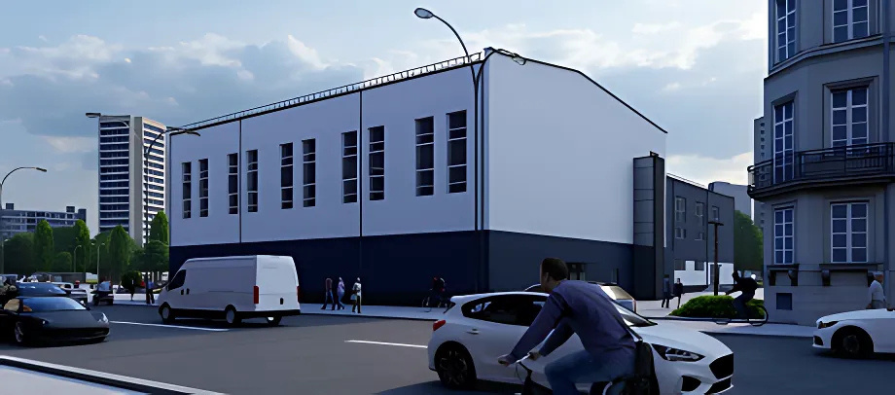
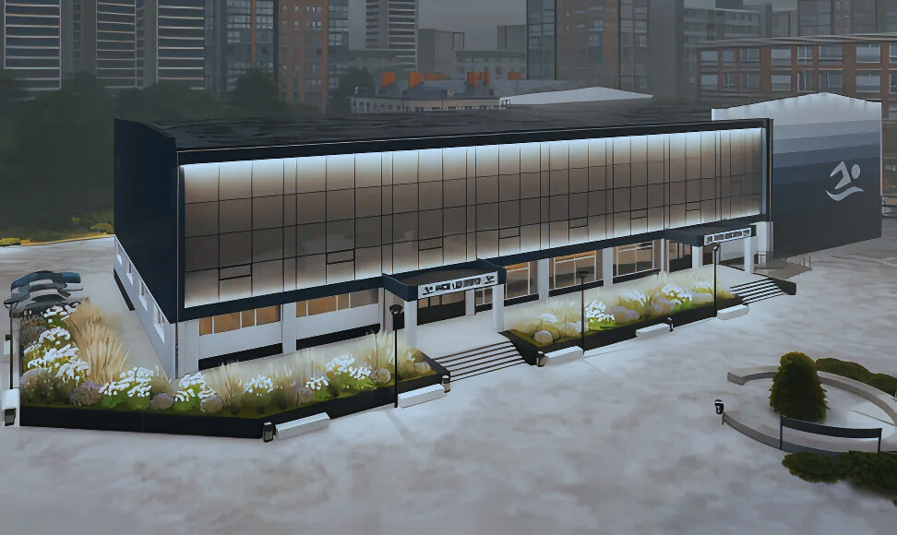
The lack of funds
1 230 000,00 EUR

Slide 15
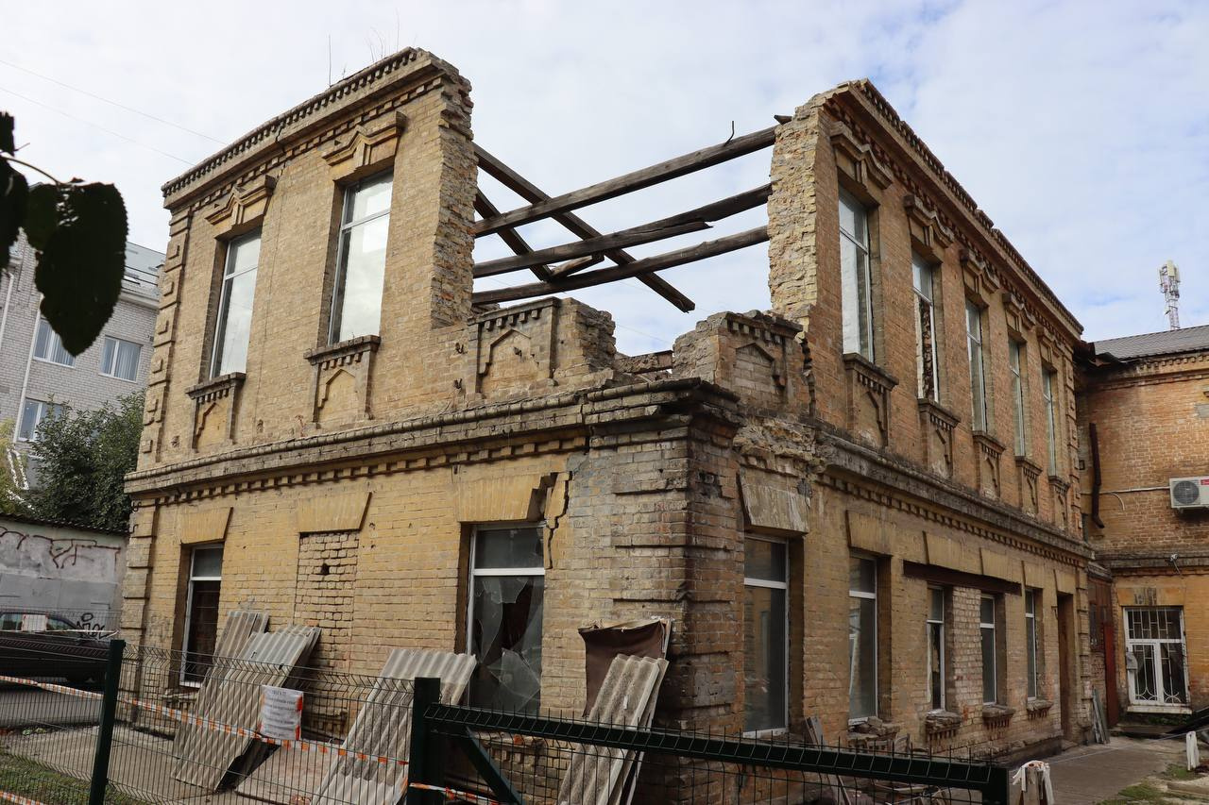
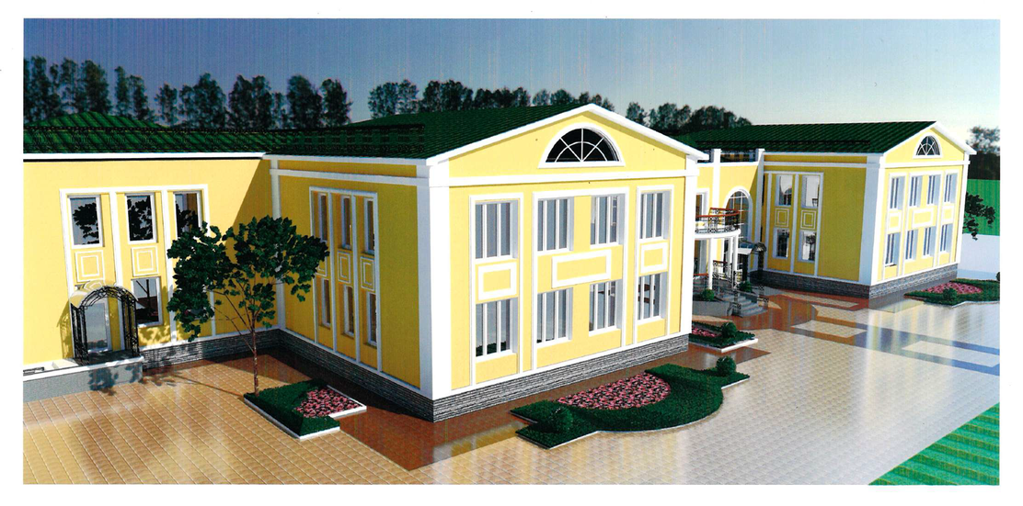
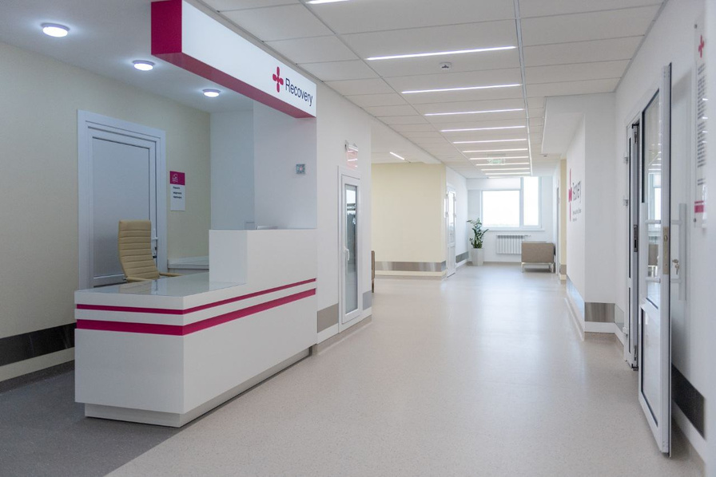
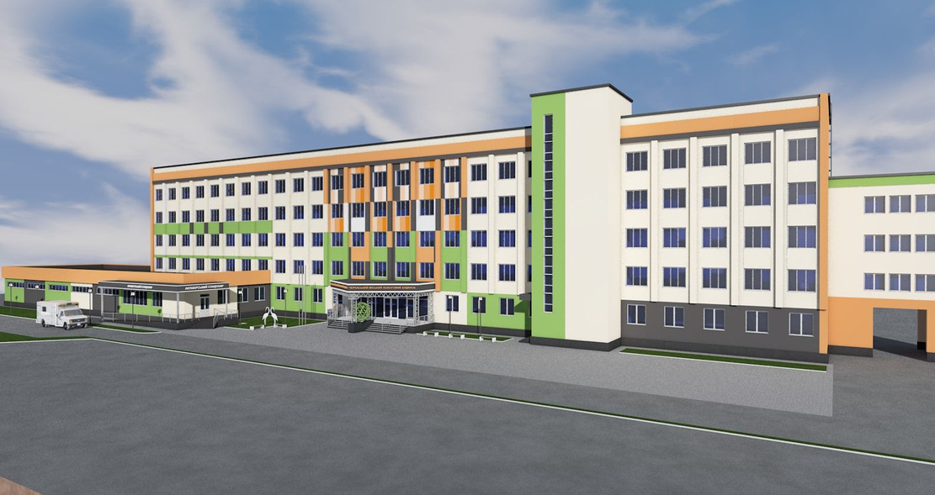
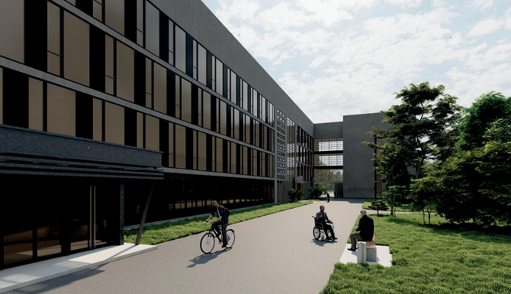
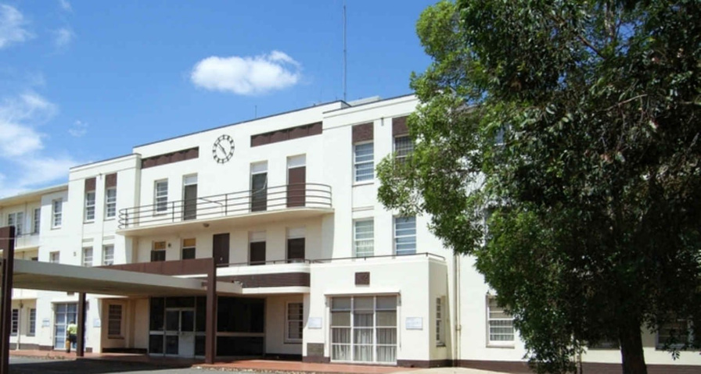
More reconstruction projects
Restoration of social infrastructure:
Restoration of the historical building of the children's music school -
370 000 EUR
Center for accommodation of internally displaced / evacuated persons - 2 150 000 EUR
Overhaul of the rehabilitation department of the emergency hospital - 1 304 500 EUR
Overhaul of the city maternity hospital - 1 780 400 EUR
Hospital department for the rehabilitation of war veterans
1 980 000 EUR
Overhaul of the city hospital -
1 207 500 EUR

Slide 16
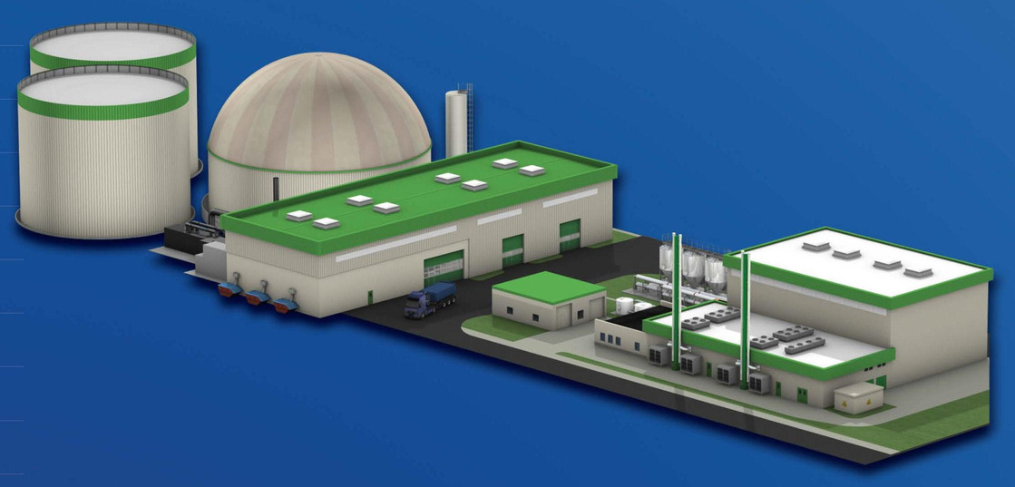
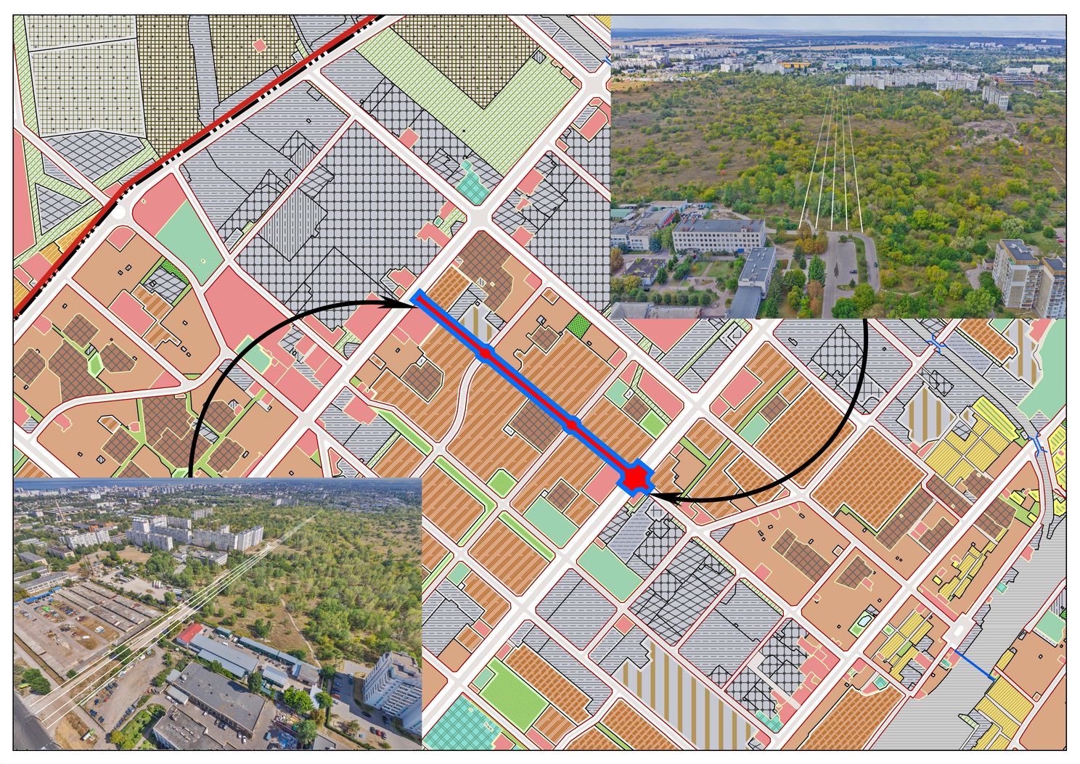
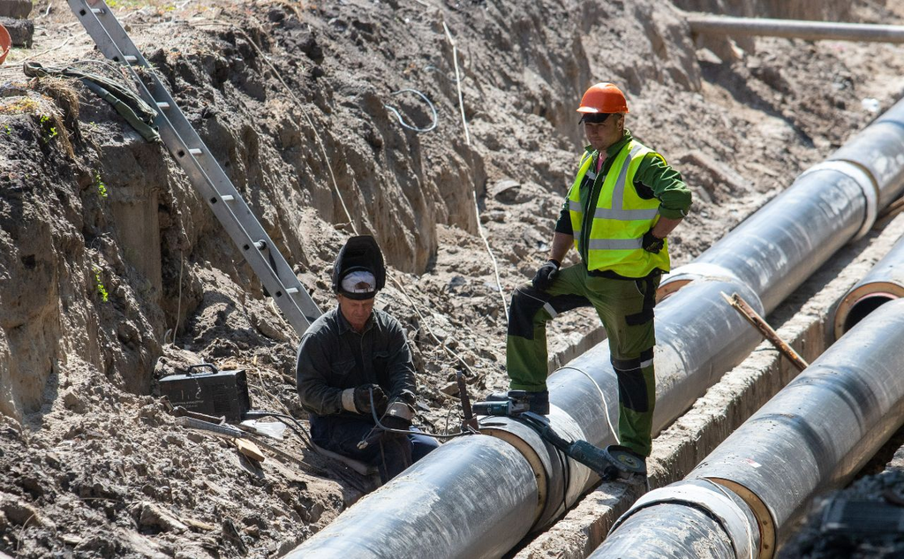
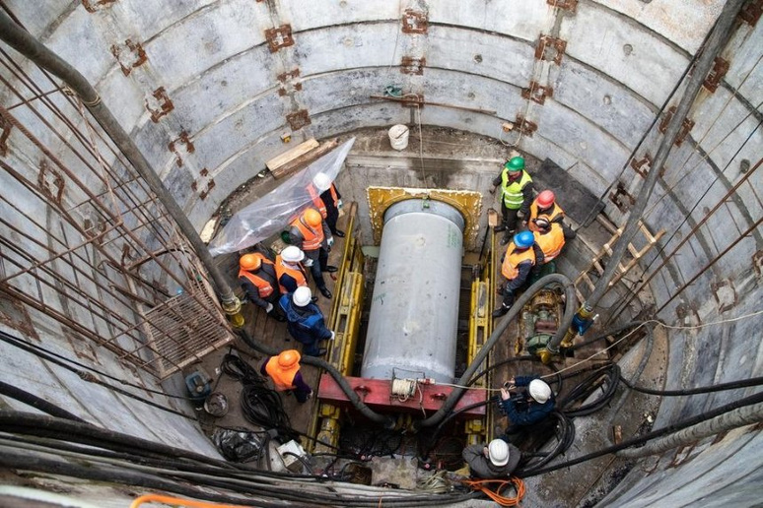
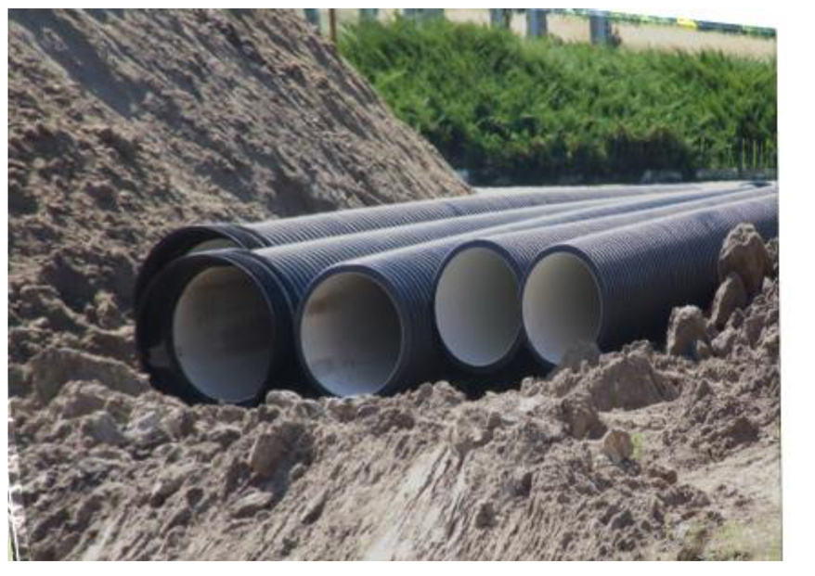
More reconstruction projects
Restoration of critical infrastructure:
Waste processing plant - 25 000 000 EUR
Construction of Kvitkova street -
4 100 000 EUR
Reconstruction of the heat supply system - 6 850 000 EUR
Reconstruction of the section of the main sewage collector- 1 932 616 EUR
Reconstruction of the section of the main sewage collector - 1 064 275 EUR

Slide 17

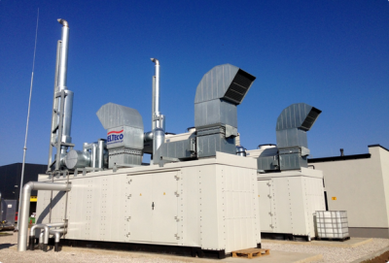
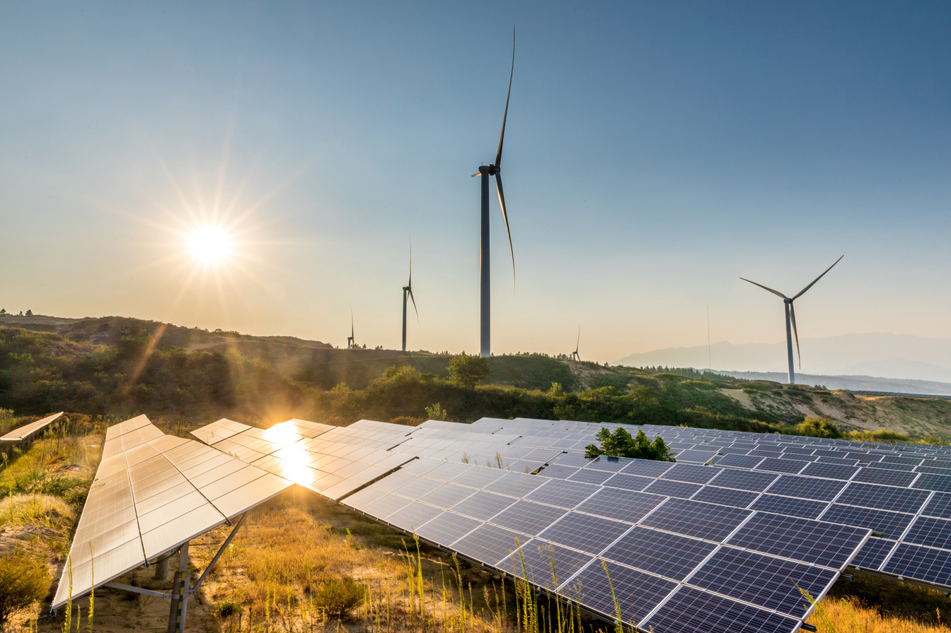

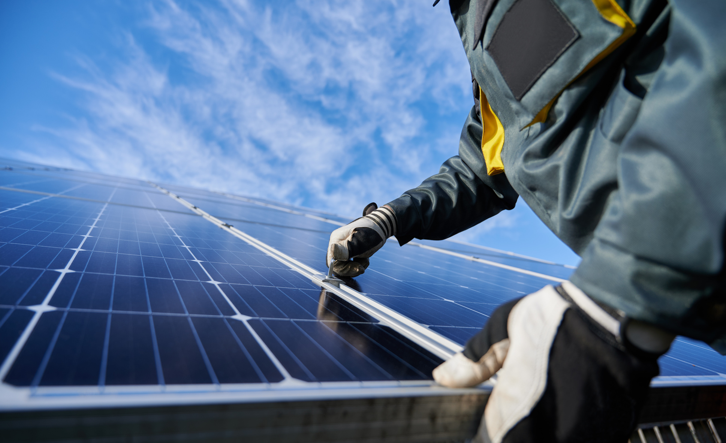

More reconstruction projects
Implementation of renewable energy:
Solar stations on the buildings of the municipal institutions -
280 000 EUR
Cogeneration gas piston unit at the Dnipro water treatment plant - 578 894 EUR
Wind power station at the Dnipro Water Treatment Plant -
2000 000 EUR
Solar power station at the Dnipro water treatment plant -
937 000 EUR
Solar power station at the reserve water intake "Vilshanka" -
932 398 EUR
Solar power station at the pumping station - 562 418 EUR

Slide 18


Thank you for your attention!
Cherkasy City Council
36 Baidy Vyshnevetskoho Street,
city of Cherkasy, Ukraine, 18000
Tel.: +38 0472-33-19-80
Mob.: +38 0636103147
E-mail: depec@ukr.net
http://chmr.gov.ua
Reconstruction projects of Cherkasy

